Slide 1
Alzheimer’s Disease Trends in the United States and Tennessee from 1999-2018
Capstone Project for Nashville Software School Data Analytics Cohort 2
John Posey
Data Analyst
Notes:
Thank you for coming to my Capstone presentation for Nashville Software School on Alzheimer's Disease fatality trends over the past 20 years. I have a personal attachment to this disease due to it being a true fear of mine and having family members that have had dementia in the later years of their lives.
This presentation will be broken down in the following areas: 1. How AD affects the brain and cognitive ability. 2. Overall trend in the United States from 1999-2018. 3. Overall trend in Tennessee from 1999-2018. 4. How to find find help if you or someone you love has AD? 5. Resources and sources for this presentation
Also included as an appendix to this presentation are slides of the parts and functions of various parts of the brain. Feel free to refer to these for further explanation of how this disease affects the brain.

Slide 2
Alzheimer’s Disease pathology and presentation
What Alzheimer’s Disease is?
how it affects those diagnosed?
Notes:
First, we will discuss what Alzheimer’s is and how it affects those diagnosed.

Slide 3
What is Alzheimer’s Disease?
According to the Alzheimer’s Association, Alzheimer’s is a subset of a mental disorder known as Dementia. It affects memory, thinking and overall behavior. Symptoms can eventually grow severe enough that they interfere with daily everyday tasks.
Notes:
*Read slide*

Slide 4
Understanding Alzheimer’s
Alzheimer’s is the most common form or cause of Dementia. Dementia is a general term for loss of memory or other cognitive abilities.
Alzheimer’s accounts for 60-80% of Dementia cases.
Alzheimer’s is not a normal part of aging. There are numerous cases of early-onset Alzheimer’s (which is anyone under 65 years of age)
Alzheimer’s currently has no cure. Treatment for symptoms is the best available course of action.
A few quick facts about Alzheimer’s disease:
Notes:
*read slide*
Note on #2: the other most common causes being Vascular Dementia and Parkinson’s Disease.

Slide 5
Alzheimer’s Disease, Brain Function, and Cognitive Decline
Ad’s effect on brain function and the resulting cognitive decline.
Notes:
Now we will discuss Alzheimer’s effect on brain function and the resulting cognitive decline.

Slide 6
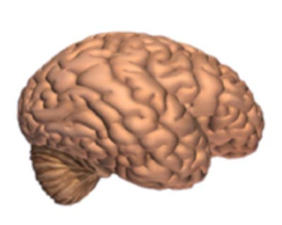
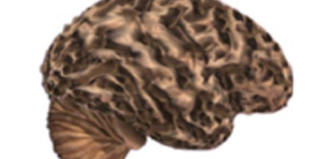
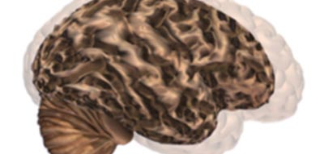
Alzheimer’s leads to nerve cell death and loss of brain tissue. The brain shrinks dramatically, greatly affecting functions.
Brain without Alzheimer’s Disease.
Brain with advanced Alzheimer’s
Comparison image of the two
No noticeable brain tissue degradation
Noticeable tissue degradation
See the difference between the two models.
Notes:
Here we see on the left a healthy brain that has no tissue degradation.
In the middle is a brain that is in the later stages of Alzheimer’s and has suffered massive tissue degradation and has subsequently shrunken substantially.
On the right, you see an overlay of the two images, showing how they relate. You can see that the brain in the latter stages in quite diminished from it counterpart.

Slide 7
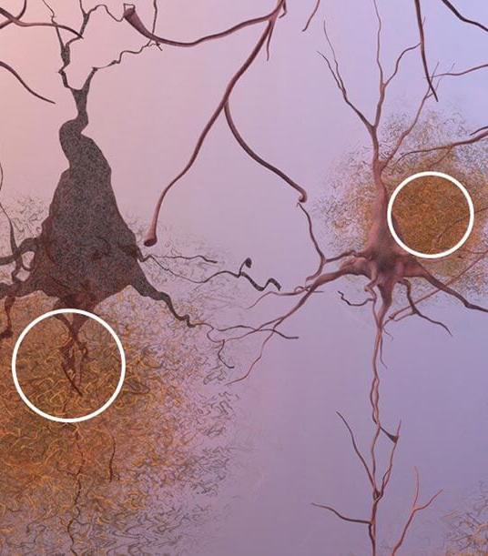
Formation of Plaques
Plaques, which are abnormal clusters of fragments of protein, gather and build up between and around the nerve cells. This picture is of brain tissue under a microscope. Scientists and Doctors are not sure what causes cell death and loss of tissue, but plaques and tangles are the current theories.
Notes:
Here we see what is theorized to be considered a major contributing factor in the development of Alzheimer’s Disease. This is the formation of plaques, or clusters of proteins, around the end of the nerve cells and neurons.

Slide 8
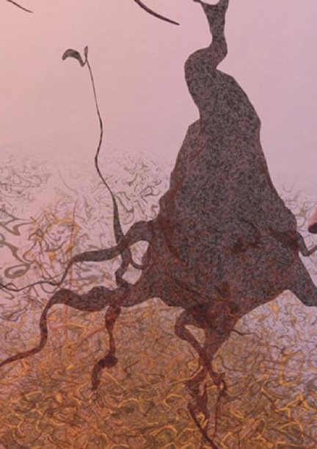
Tangles
Dead and dying nerve cells containing tangles which are twisted strands of a different protein.
Notes:
Here we have a second factor, the tangling of the nerve cell ends.

Slide 9
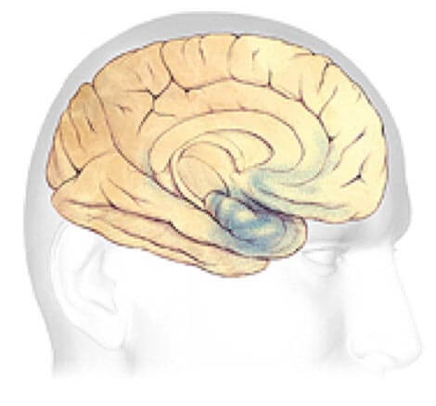
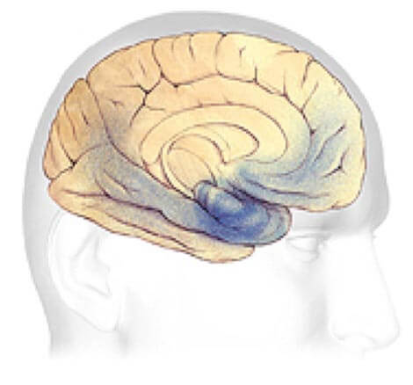
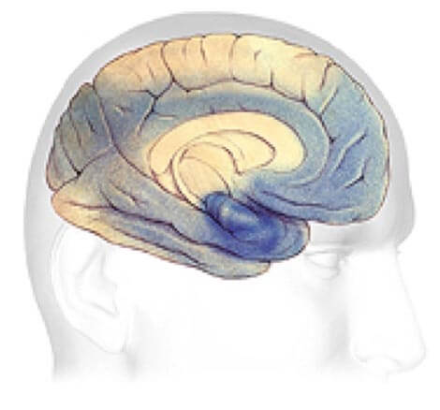
Plaque and Tangle Progression Plaque and Tangles (shown in blue) spread through the cortex. Rate of progression varies wildly from case to case.
Early Alzheimer’s
Mild to Moderate Stages
Severe, late stage
Changes to brain can begin 20 years or more before diagnosis.
Generally, lasts between 2-10 years
May last from 1-5 years.
Notes:
Here we see how plaque buildup in the nerve cells and tangles spread through the cerebral cortex of the brain, affecting functionality as it grows.
Early symptoms have been known to begin appearing as early as 20 years before official diagnosis.
Under each picture you can see approximations of how long each step can take. These are general and are not absolute.

Slide 10
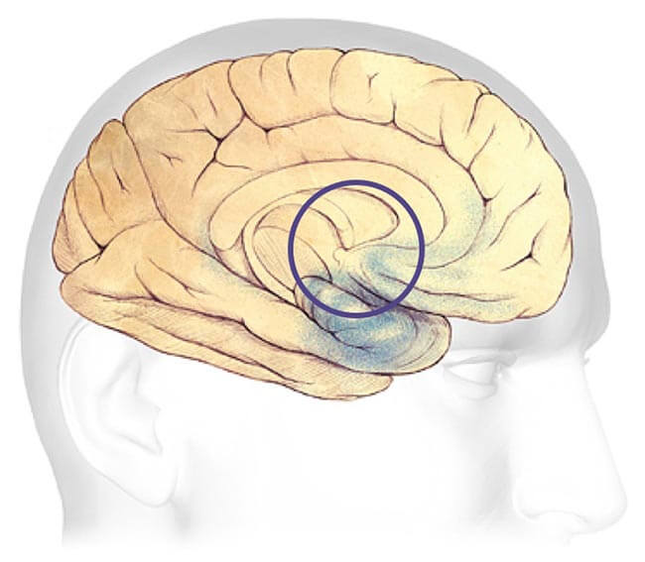
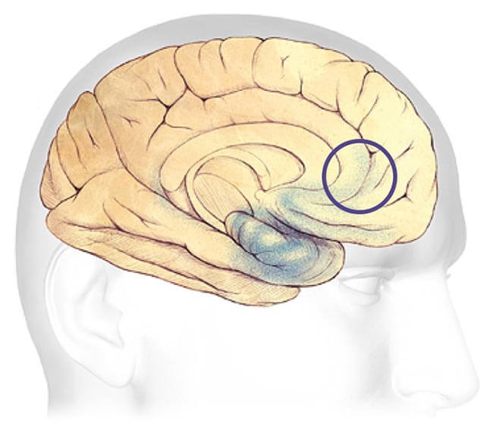
Earliest Alzheimer’s Stages
Before symptoms can be detected with tests, the plaques and tangles begin forming in the areas of the brain most involved with:
Learning and Memory
Thinking and Planning
Notes:
At its earliest stage, Alzheimer’s affects the learning and memory, and thinking and planning sections of the brain. These portions of the brain are seen in the diagrams on the right.

Slide 11
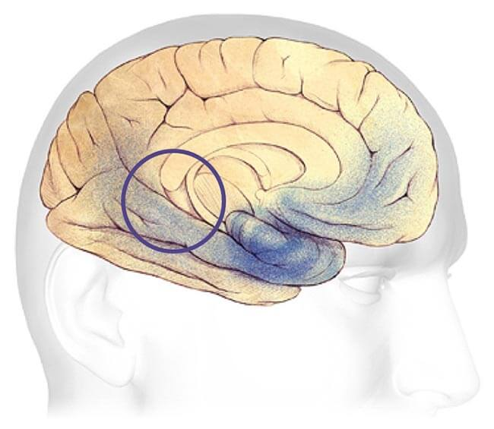
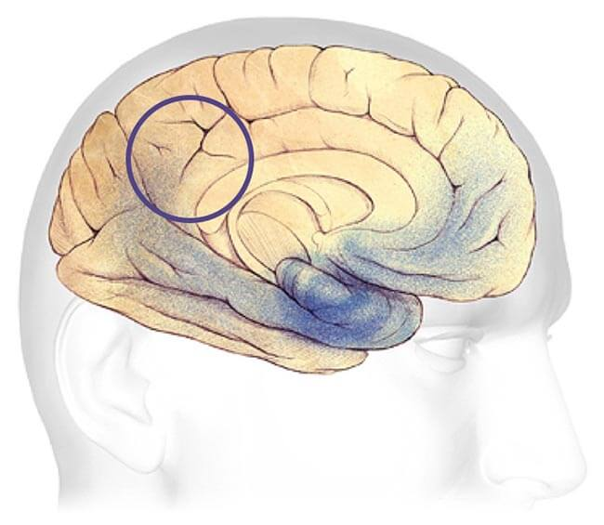
Mild - Moderate Alzheimer’s Stages
Most common stage of diagnosis. Develop problems with memory or thinking that affects daily life. Might also start getting confused and have issue handling money, expressing themselves, or even organizing thoughts.
Speaking and Understanding Speech
Sense of bodily position to objects
Notes:
As Alzheimer's Disease progresses through the brain, it begins to have a noticeable effect on the daily life of the subject. The person may begin being confused easily or not be able to handle money as easily as before. They may begin have problems expressing themselves or even organizing their thoughts.
Now, this is not just being at a loss for words or not being able to decide the proper word. This is not being able to finish simple sentences or rudimentary expressions.

Slide 12
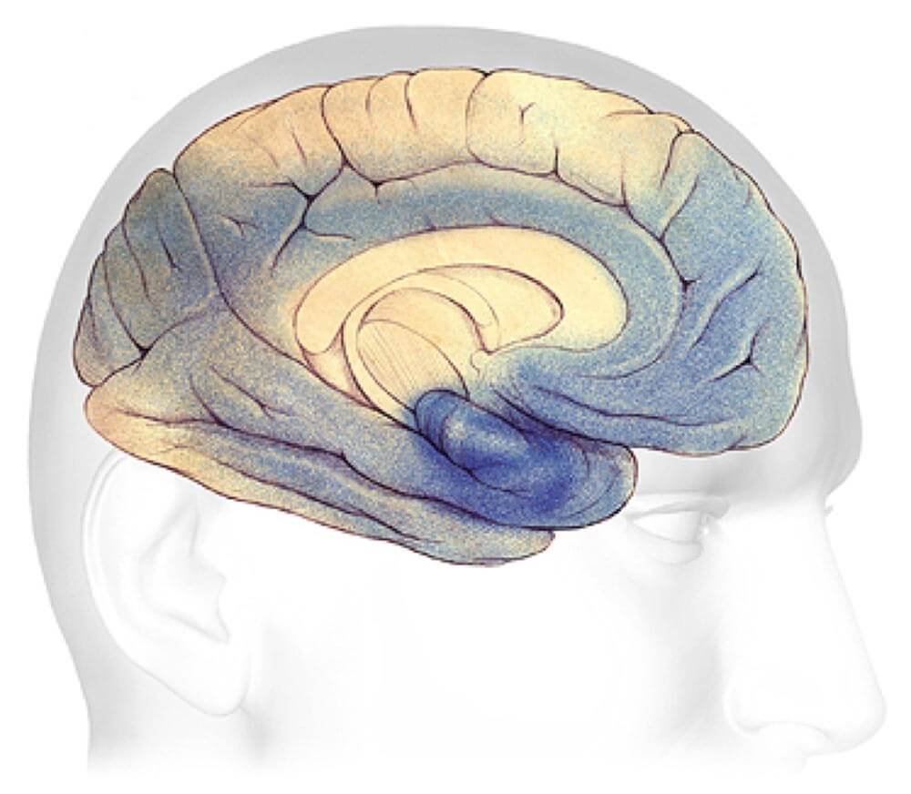
severe Alzheimer’s Stage
Most of the cortex has been severely damaged. Brain will shrink dramatically due to widespread brain cell death.
Loss of ability to communicate
Failure to recognize family or loved ones or care for self
Notes:
Finally, we have the most advanced stage of Alzheimer’s Disease where the subject has lost most or all ability to communicate and has major difficulty recognizing close individuals such as family or close friends.
You can see in the diagram that the plaque has moved almost completely throughout the entire cortex.

Slide 13
Power Bi Presentation
Alzheimer's Disease Presentation
Notes:
I will now present my findings. This is available on the PowerBi website, under my dashboard.

Slide 14
What to do if You or someone you love has Alzheimer’s Disease?
A short guide for Family and friends
Notes:
Now, I will share some quick tips if you are diagnosed or have a loved one that is diagnosed.

Slide 15
First Steps
Don’t Panic.
There is support and a community there for you and/or your loved one.
Talk to your Doctor.
Notes:
First, do not panic
There is a phenomenal community that is there to support you either as patient, caregiver, or support member.
Next, talk to your Doctor. They will explain what your individual best course of action will be.

Slide 16
next Steps
Contact your local Alzheimer’s Association.
They can help with getting you in touch with AD and Dementia specialists in your area.
Start making legal and financial plans.
Notes:
Next, contact your local Alzheimer’s Association. They are a wonderful source of information and support. They can help you understand what Alzheimer’s Disease, and it parent condition Dementia, are and what to do next.
As soon as you can after diagnosis, you will want to begin the process of getting you legal and financial affairs and plans in order. The earlier this is completed, the less stress and worry you and your friends or family will have later.

Slide 17
Further Steps
Live Well.
Reduce Stress
Embrace your community
Become an Advocate or Leader
Participate in Clinical Trials
Help to overcome the stigma
Notes:
Finally,
Remember to live well. Reduce the stress in your life. I know it will be a stressful time but removing stress can lessen the effect of the disease.
Embrace the community that you or your family member has now become a member. It is there to help you and support you.
Become an Advocate or Community Leader regarding Alzheimer’s. The more individuals that there are out there helping other patients and families the better.
Participate in any clinical trials that you feel comfortable. There is always research happening and you may be able to help crack the code and save others.
Finally, with all of these you can and will be helping to overcome the public stigma that is associated with the disease. Many people are able to live a full life, even after their diagnosis.

Slide 18



Resources
Links to various organizations and programs for help.
Tennessee Chapter
Notes:
I would like to give credit to the wonderful research, data, and resources that I used from these organizations.

Slide 19
More Resources
24/7 Helpline
1-800-272-3900
Education Programs
Alzheimer’s Association Programs
https://www.alz.org/help-support/i-have-alz/programs-support
Notes:
Here is a further resource that can be reached for more aid and education.

Slide 20
Thank you!
Thank you so much for being here and participating in this presentation.
Questions?
Comments?
Notes:
Thank you so much for being here today and participating in this presentation. I would like to open it up now for questions and comments.

Slide 21

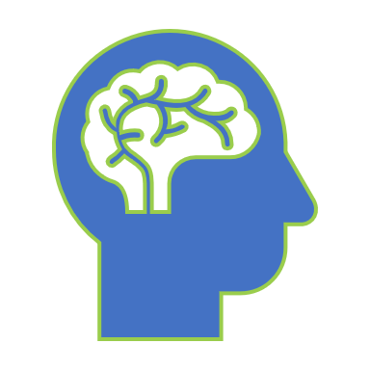
How does your Brain work?
Notes:
First, we will start by briefly describing the main portions of the brain and what they do.

Slide 22
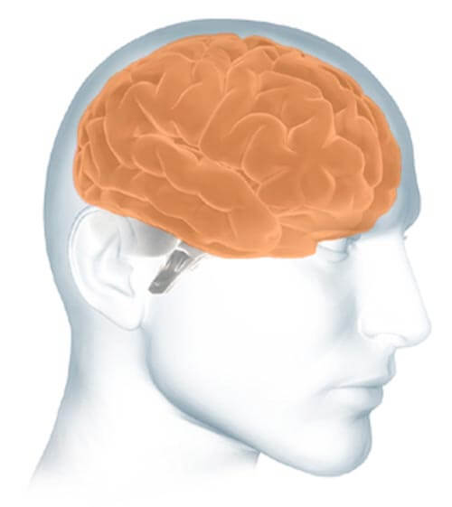
Parts of the Brain
The cerebrum fills up most of your skull. It is involved in remembering, problem solving, thinking, and feeling. It also controls movement.
https://www.alz.org/alzheimers-dementia/what-is-alzheimers/brain_tour

Slide 23
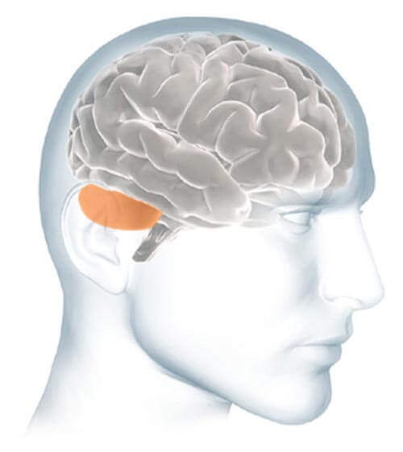
Parts of the Brain
The cerebellum sits at the back of your head, under the cerebrum. It controls coordination and balance.
https://www.alz.org/alzheimers-dementia/what-is-alzheimers/brain_tour

Slide 24
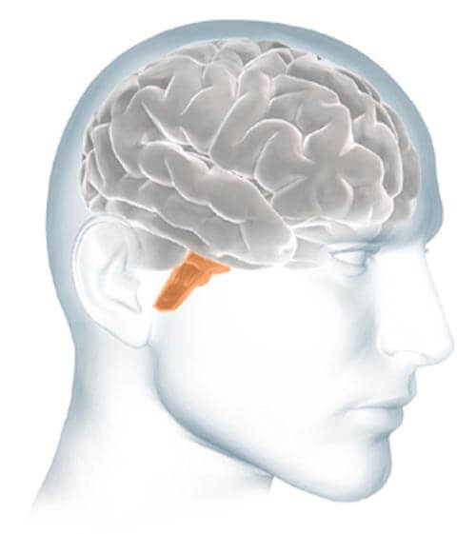
Parts of the Brain
The brain stem sits beneath your cerebrum in front of your cerebellum. It connects the brain to the spinal cord and controls automatic functions such as breathing, digestion, heart rate and blood pressure.
https://www.alz.org/alzheimers-dementia/what-is-alzheimers/brain_tour

Slide 25
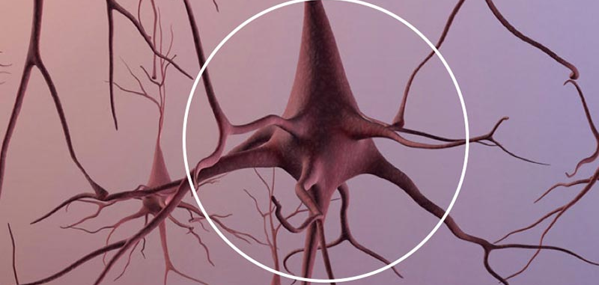
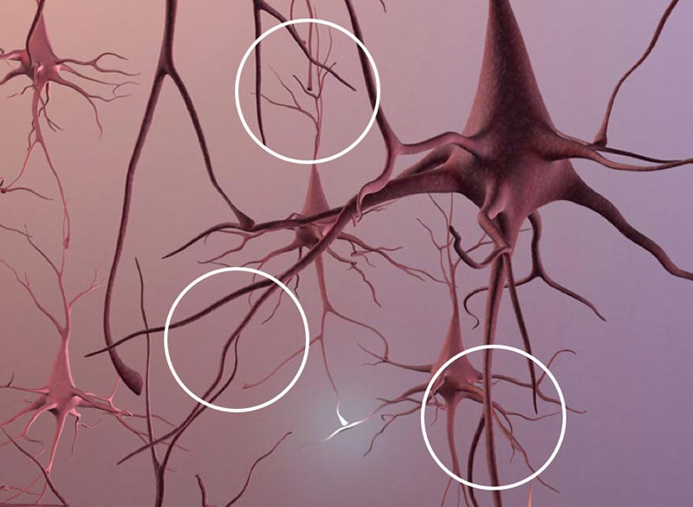
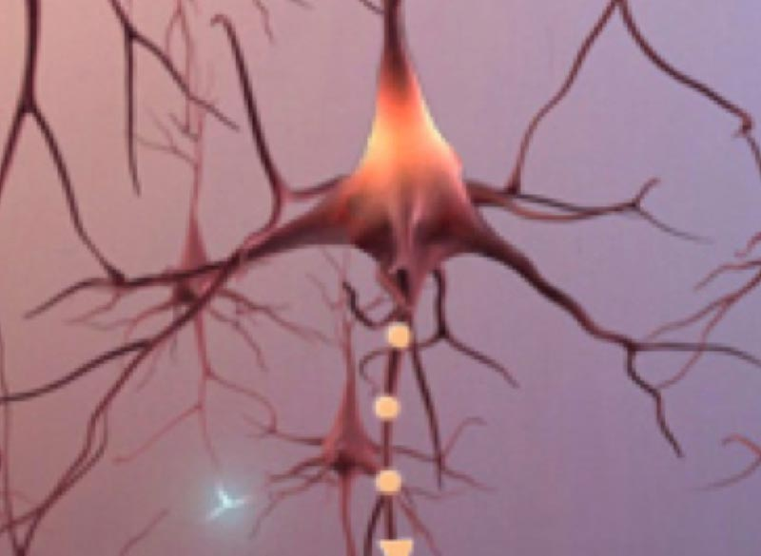
Neurons
Total Neurons
Branches
Signals
An adult brain contains about 100 billion nerve cells.
Branches connect the nerve cells at more than 100 trillion points. Scientists call this dense, branching network a "neuron forest."
Signals traveling through the neuron forest form the basis of memories, thoughts, and feelings.
Notes:
Next, we will look at the neurons. Neurons are cells within the nervous system that transmit information.

Slide 26

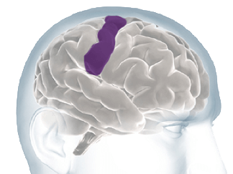
Interpret Sensations From Your Body
Notes:
Now, we will look at the portion of the brain known as the Cortex.
There are multiple points of the Cortex:
Briefly these are the
1. Renal Cortex
2. Adrenal Cortex
3. Thymic Cortex
4. Cerebral Cortex, where most of the effects of Alzheimer’s Disease take place.

Slide 27
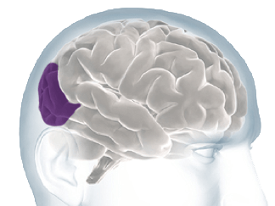
Processing Sights

Slide 28
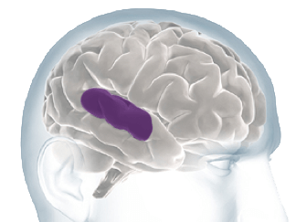
Processing Sounds

Slide 29
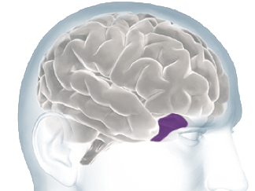
Processing Smells

Slide 30
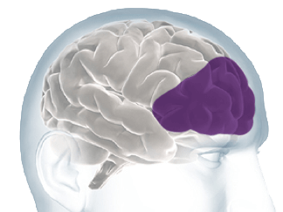
Thoughts, Problem Solving And Planning

Slide 31
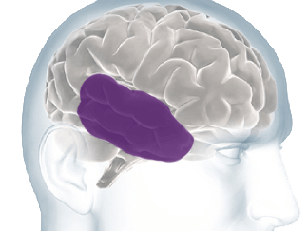
Forming & Storing Memories

Slide 32
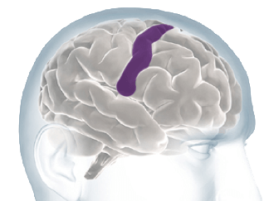
Controlling Voluntary Movement

